Slide 1
Linked Lists
Single Linked Lists

Slide 2

Linked List
A linked list is a linear collection of data elements (called nodes), where the linear order is given by means of pointers.
Each node is divided into 2 parts:
1st part contains the information of the element.
2nd part is called the link field or next pointer field which contains the address of the next node in the list.
struct node{
int data;
node *next;
node(int value)
{
data=value;
next=NULL;
}
}

Slide 3
Basic Operations
Insert: Add a new node in the first, last or interior of the list.
Delete: Delete a node from the first, last or interior of the list.
Search: Search a node containing particular value in the linked list.

Slide 4
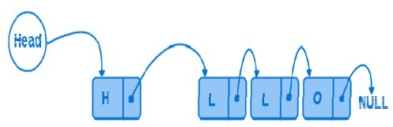
Linked List (Insertion)
Add a new node at the first, last or interior of a linked list

Slide 5
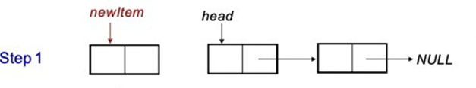

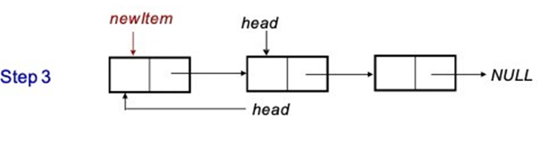
Insert First
Step 1. Create a new node that is pointed by pointer newItem.
Step 2. Link the new node to the first node of the linked list.
Step 3. Set the pointer head to the new node.

Slide 6
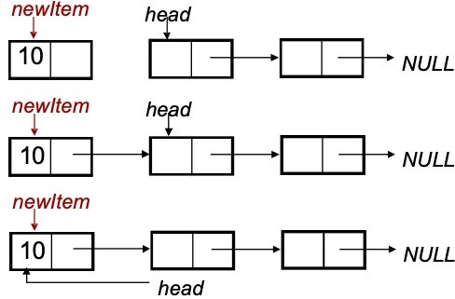
Insert First
struct node{
int value;
node *next;
};
node *head=NULL;
void insertHead(int value){
//create a new node
node *newItem= new node(value);
//insert the new node at the head
newItem->next = head;
head = newItem;
}

Slide 7
Printing Linked List
void printList()
{
if (head == NULL) // no list at all
return;
node *cur = head;
while (cur != NULL)
{
cout<<cur->data<<“ ”<<endl;
cur = cur->next;
}
}

Slide 8

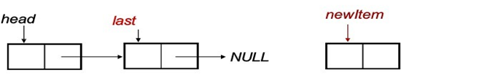
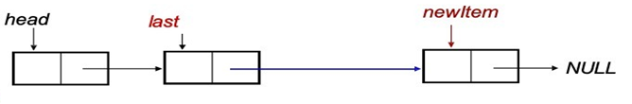
Insert Last
Step1. Create the new node.
Step2. Set a temporary pointer last to point to the last node.
Step3. Set last to point to the new node.

Slide 9
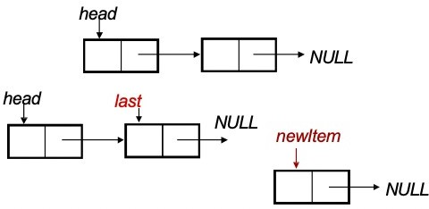

Insert Last
struct node{
int value;
node *next;
};
struct node *head;
void insertTail(int value){
//create a new node to be inserted
node *newItem= new node(value);
// set last to point to the last node of the list
node *last = head;
while (last->next != NULL)
last = last->next;
last->next = newItem;
}

Slide 10


Insert Middle
(after a desired node)
void insertMiddle(int target, int value){
//create a new node to be inserted
node *newItem= new node(value);
// set prev to point to the desired node of the list
node *prev = head;
while (prev->data != target){
prev = prev->next;
}
newItem->next = prev->next;
prev->next = newItem;
}

Slide 11
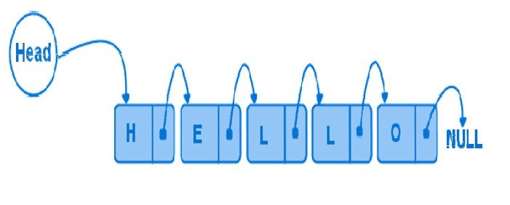
Deletion from a Linked List
Deletion can be done
At the first node of a linked list.
At the end of a linked list.
Within the linked list.

Slide 12
Delete First
To delete the first node of the linked list, we not only want to advance the pointer head to the second node
But we also want to release the memory occupied by the abandoned node.

Slide 13
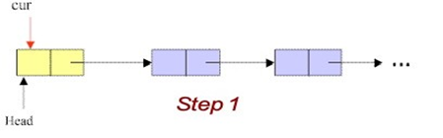
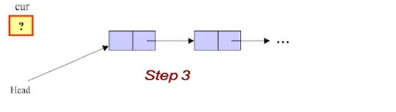
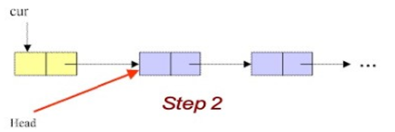
Delete First
Step1. Initialize the pointer cur point to the first node of the list.
Step2. Move the pointer head to the second node of the list.
Step3. Remove the node that is pointed by the pointer cur.

Slide 14
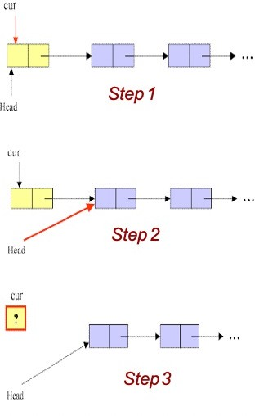
Delete First
void deleteHead()
{
node *cur;
if (head = = NULL) //list empty
return;
cur = head; // save head pointer
head = head->next; //advance head
delete cur;
}

Slide 15
Delete Last
To delete the last node in a linked list, we use a local variable, cur, to point to the last node. We also use another variable, prev, to point to the second last node in the linked list.

Slide 16
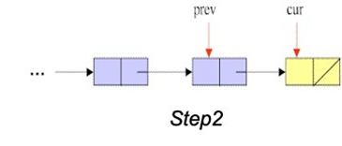
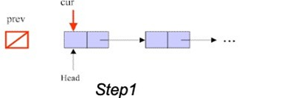
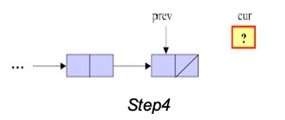
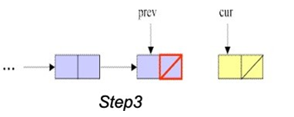
Delete Last
Step1. Initialize pointer cur to point to the first node of the list, while the pointer prev has a value of NULL.
Step2. Traverse the entire list until the pointer cur points to the last node of the list.
Step3. Set NULL to next field of the node pointed by the pointer prev.
Step4. Remove the last node that is pointed by the pointer cur.

Slide 17
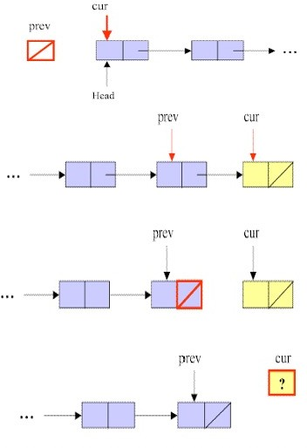
Delete Last
void deleteTail(){
if (head == NULL) //list empty
return;
node *cur = head;
node *prev = NULL;
while (cur->next != NULL){
prev = cur;
cur=cur->next;
}
if (prev != NULL) prev->next = NULL;
else head = NULL;
delete cur;
}

Slide 18
Delete Any
To delete a node that contains a particular value x in a linked list, we use a local variable, cur, to point to this node, and another variable, prev, to hold the previous node.

Slide 19
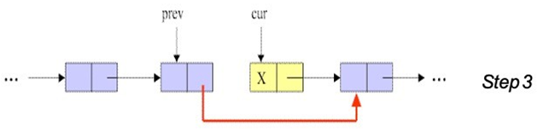


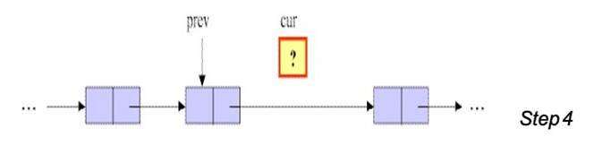
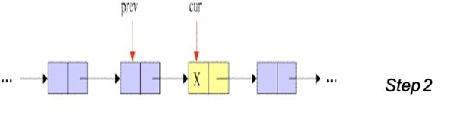
Delete Any
Step1. Initialize pointer cur to point to the first node of the list, while the pointer prev has a value of null.
Step2. Traverse the entire list until the pointer cur points to the node that contains value of x, and prev points to the previous node.
Step3. Link the node pointed by pointer prev to the node after the cur’s node.
Step4. Remove the node pointed by cur.

Slide 20
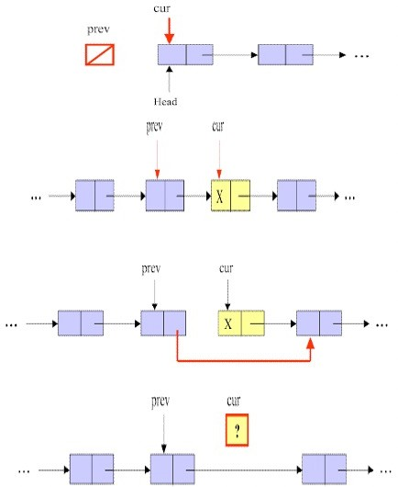
Delete Any
void deleteAny( int x){
if (head == NULL) //list empty
return;
node *cur = head;
node *prev = NULL;
while (cur->data != x){
prev = cur;
cur=cur->next;
}
if (prev != NULL)
prev->next = cur->next;
else head = NULL;
delete cur;
}

Slide 21
Search
Can you write an algorithm for search?
Can you reuse any previously written code segment?
How will you handle the case when an eleent is not present in the list?

Slide 22
Thank You

